Slide 1


HR Analytics Dashboard
Final Milestone - Infosys Springboard Internship
Presented by,
Shaleny T S
Team 3
Notes:
1

Slide 2


Team Members
Rifana Sherin
Shalini
Anusha
Jatin
Harsha
Akshara
Notes:
2

Slide 3
Importance of Data Analysis
Data analysis provides critical insights into workforce trends, employee performance, and overall organizational health. By analyzing data, HR professionals can make data-driven decisions that improve recruitment strategies, optimize employee retention, enhance productivity, and ultimately achieve business objectives more effectively.
Key Benefits:
Improved workforce planning
Reduced employee turnover
Increased employee engagement
Support evidence-based decision-making
Notes:
3

Slide 4

Importance of HR Data Analysis-
Employee Engagement
Talent Acquisition
HR analytics helps understand factors driving employee satisfaction and engagement, leading to improved retention and productivity.
Data analysis helps optimize recruitment processes, identify high-performing candidates, and predict candidate success.
Performance Management
Data provides insights into individual and team performance, supporting performance improvement strategies and employee development.
Notes:
Data analytics is a powerful tool for HR to drive meaningful insights and improvements across the organization
By understanding factors that influence employee engagement, we can take targeted actions to boost satisfaction, retention, and productivity
Analyzing recruitment data allows us to optimize our processes, identify high-potential candidates, and predict their future success
Performance data gives us visibility into individual and team performance, enabling us to develop tailored strategies for improvement and growth
4

Slide 5
Data Overview
Data Source
Description
Employee Database
Contains basic information about employees, such as demographics, job titles, and salary.
Performance Reviews
Provides data on employee performance, including ratings, feedback, and goals.
Training Records
Tracks employee participation in training programs and development opportunities.
Surveys
Collects feedback from employees on various aspects of their work experience, such as job satisfaction and company culture.
Notes:
5

Slide 6

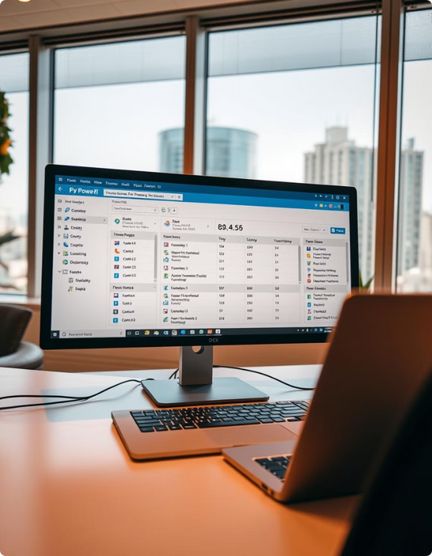
DAX Formulas Used
CALCULATE
SUM
Used to calculate measures and filter data based on specific conditions.
Calculates the sum of a column or expression, commonly used for total revenue or expenses.
AVERAGE
COUNT
Calculates the average of a column or expression, often used for performance metrics and satisfaction scores.
Counts the number of rows or distinct values in a column, useful for tracking employee headcount or customer acquisition.
Notes:
6

Slide 7




Dashboard Overview
Performance Metrics
Geographic Distribution
Time-Series Analysis
Provides key performance indicators (KPIs) on employee engagement, productivity, and retention.
Visualizes employee demographics and workforce distribution across different locations.
Tracks trends over time, enabling insights into seasonal patterns and long-term performance.
Employee Profiles
Provides detailed information about individual employees, including their skills, experience, and performance history.
Notes:
7

Slide 8

Visualization
Bar Charts
Line Charts
Pie Charts
Compare employee performance metrics across different departments or teams, highlighting key strengths and weaknesses.
Track key performance indicators (KPIs) over time, revealing trends and patterns in employee engagement, productivity, and retention.
Visualize the distribution of employees across various demographics or categories, such as age, gender, or department, providing a clear overview of the workforce composition.
Notes:
8

Slide 9
Insights from Dashboard
The HR analytics dashboard we've developed provides a comprehensive view of key trends in our workforce.
The geographic distribution patterns and time-series analysis revealed in the dashboard offer valuable insights to inform our strategic workforce planning.
I'll highlight some of the key findings from the dashboard that can help guide our decisions around talent management and organizational development.
Notes:
• The HR analytics dashboard we've developed provides a comprehensive view of key trends in our workforce.
• By integrating data from various sources like employee records, performance reviews, and surveys, the dashboard gives us a holistic picture.
• The geographic distribution patterns and time-series analysis revealed in the dashboard offer valuable insights to inform our strategic workforce planning.
• I'll highlight some of the key findings from the dashboard that can help guide our decisions around talent management and organizational development.
9

Slide 10
Key Metrics and Trends
1
Employee Turnover
Tracks the rate of employee departures, identifying potential issues with retention and employee satisfaction.
2
Employee Satisfaction
Measures employee morale and overall job satisfaction, highlighting areas where improvements can be made.
3
Training and Development
Tracks employee participation in training programs and skill development initiatives, assessing the effectiveness of these programs.
4
Performance Management
Monitors employee performance and progress towards goals, identifying areas for improvement and recognition.
Notes:
10

Slide 11
Significance of HR Analytics
Improved Employee Experience
Enhanced Efficiency
Data-Driven Decisions
HR processes become more efficient and streamlined by leveraging data insights to automate tasks and improve workflows.
Data-driven insights help organizations understand employee needs and preferences, leading to better employee engagement and retention.
HR analytics empowers organizations to make data-driven decisions, leading to more effective HR strategies.
Notes:
11

Slide 12
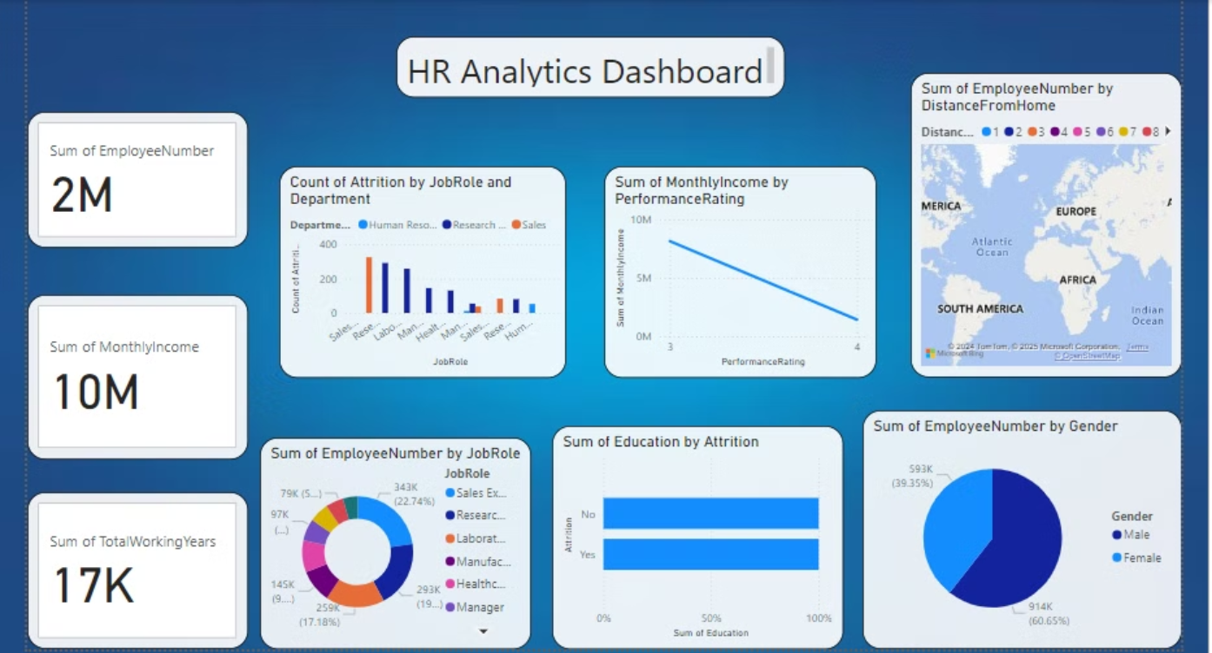
Dashboard - Page 1
Notes:
12

Slide 13
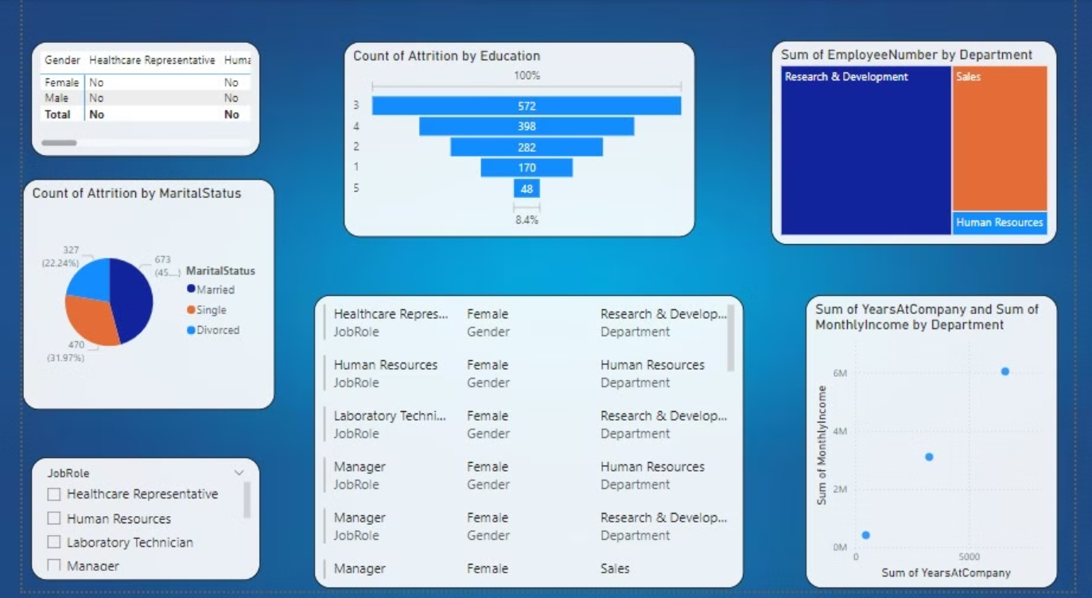
Page 2
Notes:
13

Slide 14
Thank You
Notes:
14

